Slide 1
Office Computer Application WEEK EIGHT
Muhammad Unggul Pamenang

Slide 2
Please Do It With MS PowerPoint from 2010 - 2016

Slide 3
Inserting Videos
1
MS PowerPoint 2016

Slide 4
Introduction
PowerPoint allows you to add audio to your presentation. For example, you could add background music to one slide, a sound effect to another, and even record your own narration or commentary. You can then edit the audio to customize it for your presentation.

Slide 5
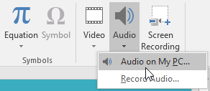
To insert audio from a file:
In our example, we'll insert an audio file saved locally on our computer. If you'd like to work along with our example, right-click this link to our example file
From the Insert tab, click the Audio drop-down arrow, then select Audio on My PC.

Slide 6
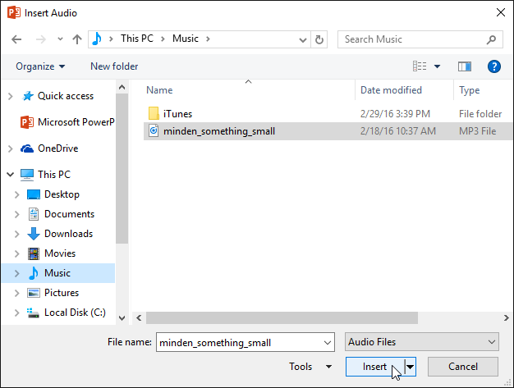
To insert audio from a file:
Locate and select the desired audio file, then click Insert.

Slide 7

To insert audio from a file:
The audio file will be added to the slide.

Slide 8
Recording your own audio
Sometimes you may want to record audio directly into a presentation. For example, you might want the presentation to include narration. Before you begin, make sure you have a microphone that is compatible with your computer; many computers have built-in microphones or ones that can be plugged in to the computer.

Slide 9
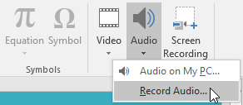
To record audio:
From the Insert tab, click the Audio drop-down arrow, then select Record Audio.

Slide 10
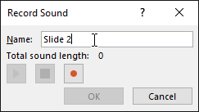
To record audio:
Type a name for the audio recording if you want.

Slide 11
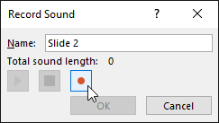
To record audio:
Click the Record button to start recording.

Slide 12
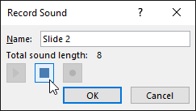
To record audio:
When you're finished recording, click the Stop button.

Slide 13
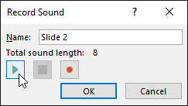
To record audio:
To preview your recording, click the Play button.

Slide 14
To record audio:
When you're done, click OK. The audio file will be inserted into the slide.

Slide 15

Working with audio
To preview an audio file:
Click an audio file to select it.
Click the Play/Pause button below the audio file. The sound will begin playing, and the timeline next to the Play/Pause button will advance.
To jump to a different part of the file, click anywhere on the timeline.

Slide 16

To move an audio file:
Click and drag to move an audio file to a new location on a slide.

Slide 17
Editing audio
You can modify your audio files using the commands on the Playback tab. For example, if you add a song to a slide you can trim it to play only a brief section. You can also add a fade in and fade out and can add bookmarks that allow you to jump to specific points in the audio file.

Slide 18
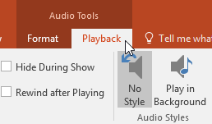
To trim an audio file:
Select the audio file, then click the Playback tab on the Ribbon.

Slide 19

To trim an audio file:
Click the Trim Audio command.

Slide 20
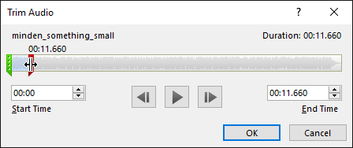
To trim an audio file:
A dialog box will appear. Use the green handle to set the start time and the red handle to set the end time.

Slide 21
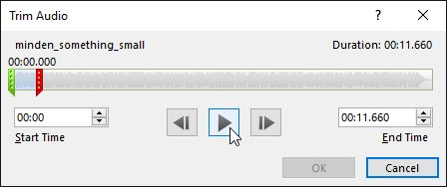
To trim an audio file:
To preview the audio file, click the Play button.
Adjust the handles again if necessary, then click OK.

Slide 22

To add a fade in and fade out:
On the Playback tab, locate the Fade In: and Fade Out: fields.
Type the desired values, or use the up and down arrows to adjust the times.

Slide 23
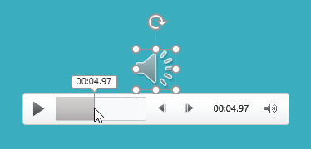
To add a bookmark:
Click the timeline to locate the desired part of the audio file.

Slide 24

To add a bookmark:
From the Playback tab, click the Add Bookmark command.

Slide 25

To add a bookmark:
The bookmark will appear on the timeline. Click the bookmark to jump to that location.

Slide 26

Audio options
There are other options you can set to control how your audio file will play. These are found in the Audio Options group on the Playback tab.

Slide 27
Audio options
Volume: Changes the audio volume
Start: Controls whether the audio file starts automatically or when the mouse is clicked
Hide During Show: Hides the audio icon while the slide show is playing
Play Across Slides: Continues playing the audio file across multiple slides instead of just the current slide
Loop until Stopped: Replays the audio file until stopped
Rewind after Playing: Returns the audio file to the beginning when it is finished playing

Slide 28
To change the audio icon:
By default, an audio file will appear as a speaker icon in the slide. If you want, you can change the icon to a different picture.

Slide 29
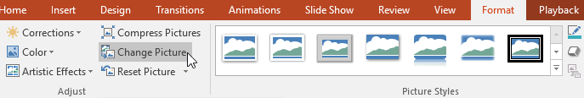
To change the audio icon:
Select the audio file, then click the Format tab.
Click the Change Picture command.

Slide 30
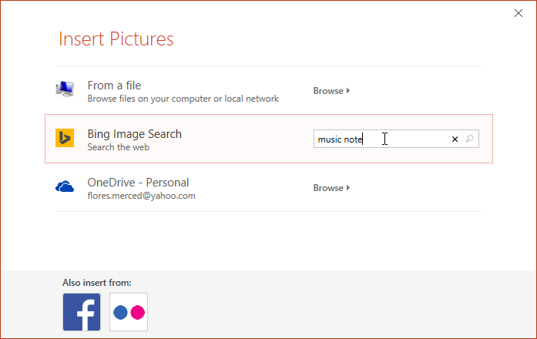
To change the audio icon:
The Insert Pictures dialog box will appear. Click Browse to select a file from your computer. Alternatively, you can use the online image search tools to locate an image online. In our example, we'll search using the phrase music note.

Slide 31
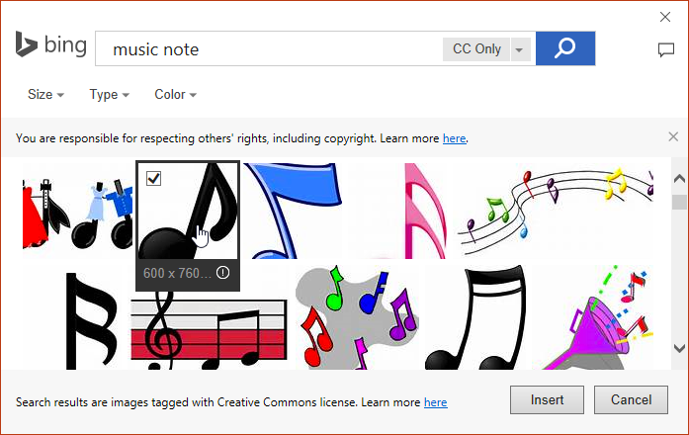
To change the audio icon:
Locate and select the desired picture, then click Insert.

Slide 32

To change the audio icon:
The icon will change to the new picture.

Slide 33
JOBSHEET
Continue working

Slide 34
THANKS!

